Slide 1


DEPARTMENT OF INFORMATION TECHNOLOGY
V R SIDDHARTHA ENGINEERING COLLEGE
Avantel Project
Health Care Management System
Domain : Health Care
B.Tech in INFORMATION TECHNOLOGY
MINI Project Review Presentation
Presented by :
RIZWANULLAH MD ( 208W1A1299 )
SRI SASHANK P ( 208W1A12B3 )
Under the guidance of
M RAMESH Asst Prof

Slide 2
AGENDA
Problem Statement
Abstract
Objectives and Outcomes
Literature review
Requirements of Project
Architecture Diagram
Flow Diagram
Implementation Plan

Slide 3
PROBLEM STATEMENT
To develop a Web application and Mobile application which provides health care services for Patients, Doctor’s, Pharmacists and Lab operators.

Slide 4
ABSTRACT
The project aims to develop a comprehensive healthcare management system through the creation of a Web application and a Mobile Application. The system will streamline and improve the healthcare experience for users by providing various features such as appointment scheduling, symptom checker, and access to medical records.
The goal is to enhance the efficiency of healthcare delivery and make it more accessible and convenient for patients.

Slide 5
OBJECTIVES
PHASE-1:
Developing the Web Application for the Health Care Management System.
PHASE-2:
Developing Mobile Application for the Health Care Management System.
PHASE-3:
Apply Authentication & Security in Web application and Mobile application. Identify and handle OWASP API Security Top 10 Vulnerabilities 2019 in APIs exposed by the web application.
Implement TLS v1.2 in APIs for securing data transfer between web server and mobile/web application. Implementation of logging and registration for all users in the proposed system. Design registrations, schedules, calendars, e-prescription through dashboard.

Slide 6
OUTCOMES
Web Application and Mobile Application for both operating systems (IOS & Android ) where users can consult a doctor via text ( or ) voice ( or ) video by scheduling an appointment before hand.
Patients are able to easily book lab tests and medicines prescribed by doctor.
It has e-prescription of doctor which will be easy for pharmacists to give medicines.

Slide 7
LITERATURE REVIEW
These applications some similar applications which provide health care service
PRACTO APP:
24/7 doctor consultations
Booking appointments and lab tests
Digital prescription
FAMILY DOCTOR APP:
Book appointments
Add them to your calendar
Get reminders
Online check-in and queue information
Important health updates

Slide 8






REQUIREMENTS OF PROJECT
Front End
Back End

Slide 9







Software Requirements
XCode
Android Studio
Windows
Kali Linux
Mobile App Requirements
Storage
VSCode

Slide 10
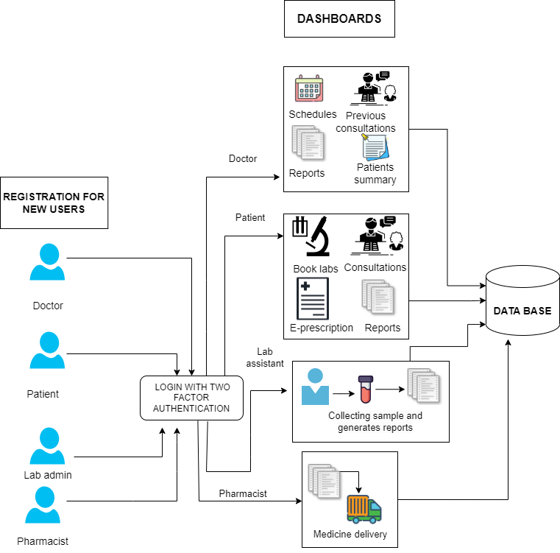
ARCHITECTURE DIAGRAM

Slide 11
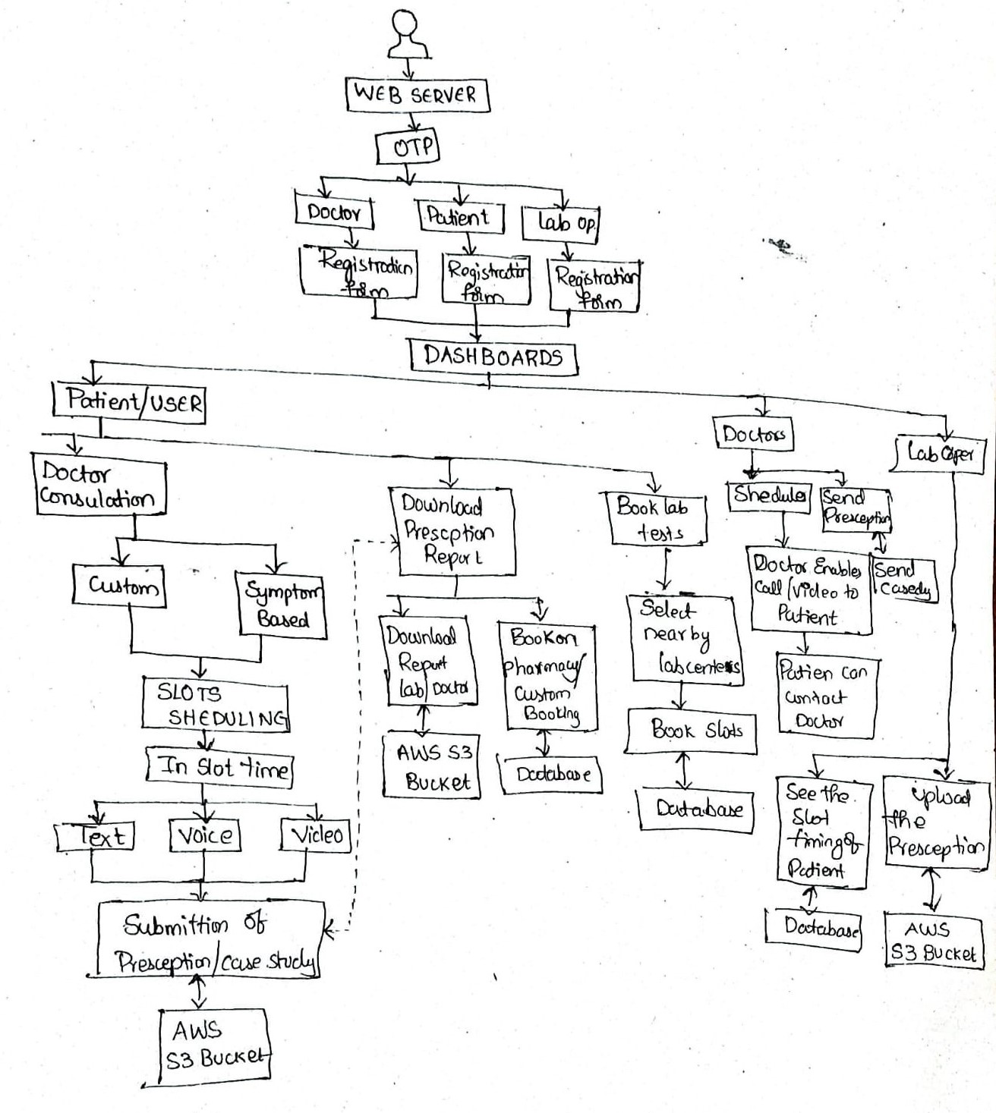
FLOW OF PROJECT

Slide 12
IMPLEMENTATION STEPS
Development of Interfaces in Web Application:
User interface (Login, Registration pages - Doctor / Patient / System Admin, Lab Admin)
Dashboard – Doctor, Patient, System Admin / Lab Admin.
Functions include - Doctor selection (with respect to symptom), Adding/updating the mapping of symptom to specialization ( if any)
Scheduling : Booking Slots, Doctor calendar generation
Consultation : Text based, Video call based and Voice call based
Prescription : e-Prescription, Patient case study, booking for lab tests
Implementation of system features like Authentication & Security, User registrations

Slide 13
THANK YOU

Slide 14
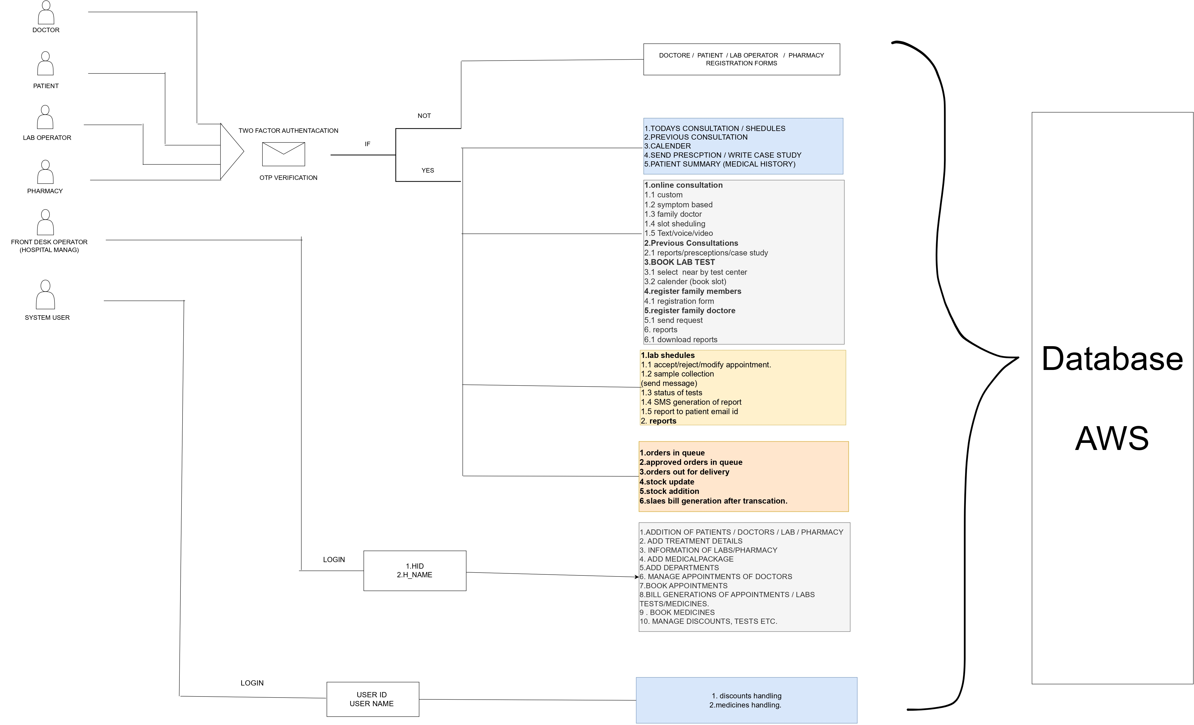
ARCHITECTURE DIAGRAM

